Slide 1
O3BNN Regularized Training and TCP-NET
2016124103 박상준

Slide 2
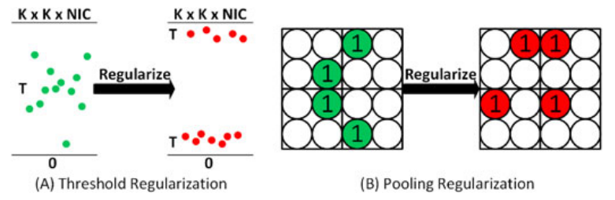
Regularized Training
Regularized Training
For Threshold-Based Pruning
For Pooling Based Pruning

Slide 3

O3BN : Regularized Training
Regularized Training For Threshold-Based Pruning
Higher chance of pruning when accumulation stays away from threshold
larger (approaching max bound K X K X NIC)
smaller (approaching min bound 0)
Adding a regularization term to the loss function
SGD-based optimizer iteratively minimizes the loss function
1. Redundancy in network parameters and input images
2. Robustness of SGD optimization

Slide 4
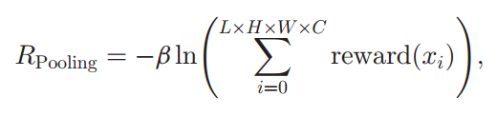


O3BN : Regularized Training
Regularization for Pooling-Based Pruning
If we encourage the first features in the evaluation chain to be 1
Pooling-based pruning will be triggered earlier
Pruning opportunities will increase
Giving differently weighted rewards to different features covered by a pooling window
1.0 | 0.6
0.3 | 0.0
=

Slide 5
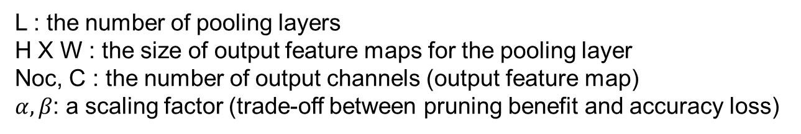
O3BN : Regularized Training
O3BNN-R training/inference co-design
Adding two regularization terms to the original loss function during training
L : the number of pooling layers
H X W : the size of output feature maps for the pooling layer
Noc, C : the number of output channels (output feature map)
$α,β$: a scaling factor (trade-off between pruning benefit and accuracy loss)
1.0 | 0.6
0.3 | 0.0
=

Slide 6
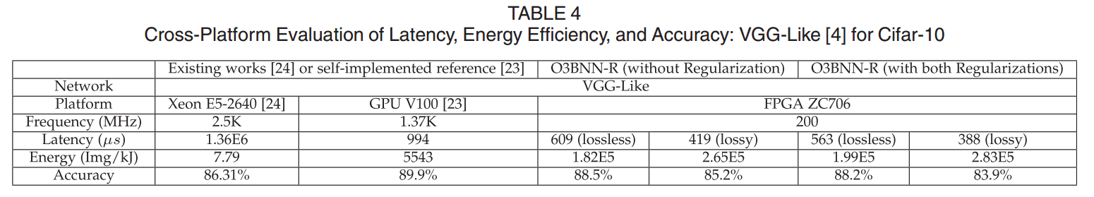

O3BN : Regularized Training
Evaluation
Latency 609 $μs$ → 563 $μs$ (7.55%)

Slide 7
TCP-Net
TCP-Net: Minimizing Operation Counts of Binarized Neural Network Inference
Published in: 2021 IEEE International Symposium on Circuits and Systems (ISCAS)
Date Added to IEEE Xplore: 27 April 2021
PROPOSED METHOD
Kernel Inclusion Similarity
Threshold-Comparable-Popcount Operation (TCP)
Tile-Based Pruning Strategy
→ Our work can cut down 79.11% of the operations with maintaining the original accuracy 88.7%

Slide 8
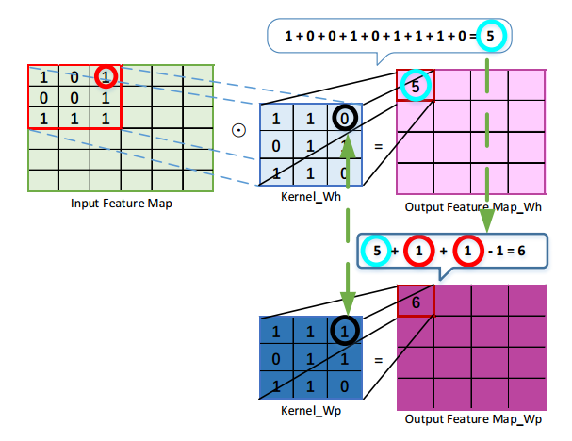


TCP-Net
Threshold-Comparable-Popcount Operation (TCP)
Kernel Inclusion Similarity
$y_{p}=y_{h}+f_{j}+f_{j}−1$
$y_{p}$ = 5 + 1 + 1 - 1 = 6

